Slide 1

Learning Outside the Classroom Parent Pack: Secondary
‘Learning Outside the Classroom (LOtC) is the use of places other than the classroom for teaching and learning. It is about getting children and young people out and about, providing them with challenging, exciting and different experiences to help them learn’.
- Council for Learning Outside the Classroom

Slide 2
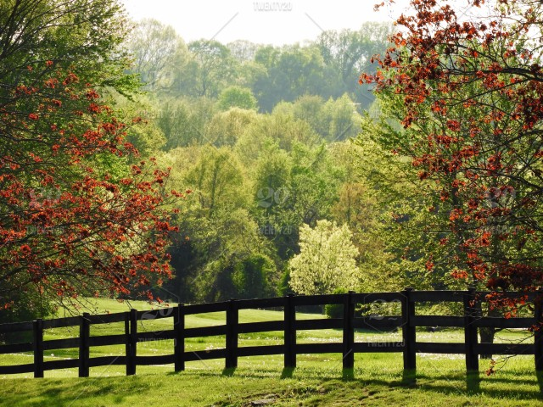
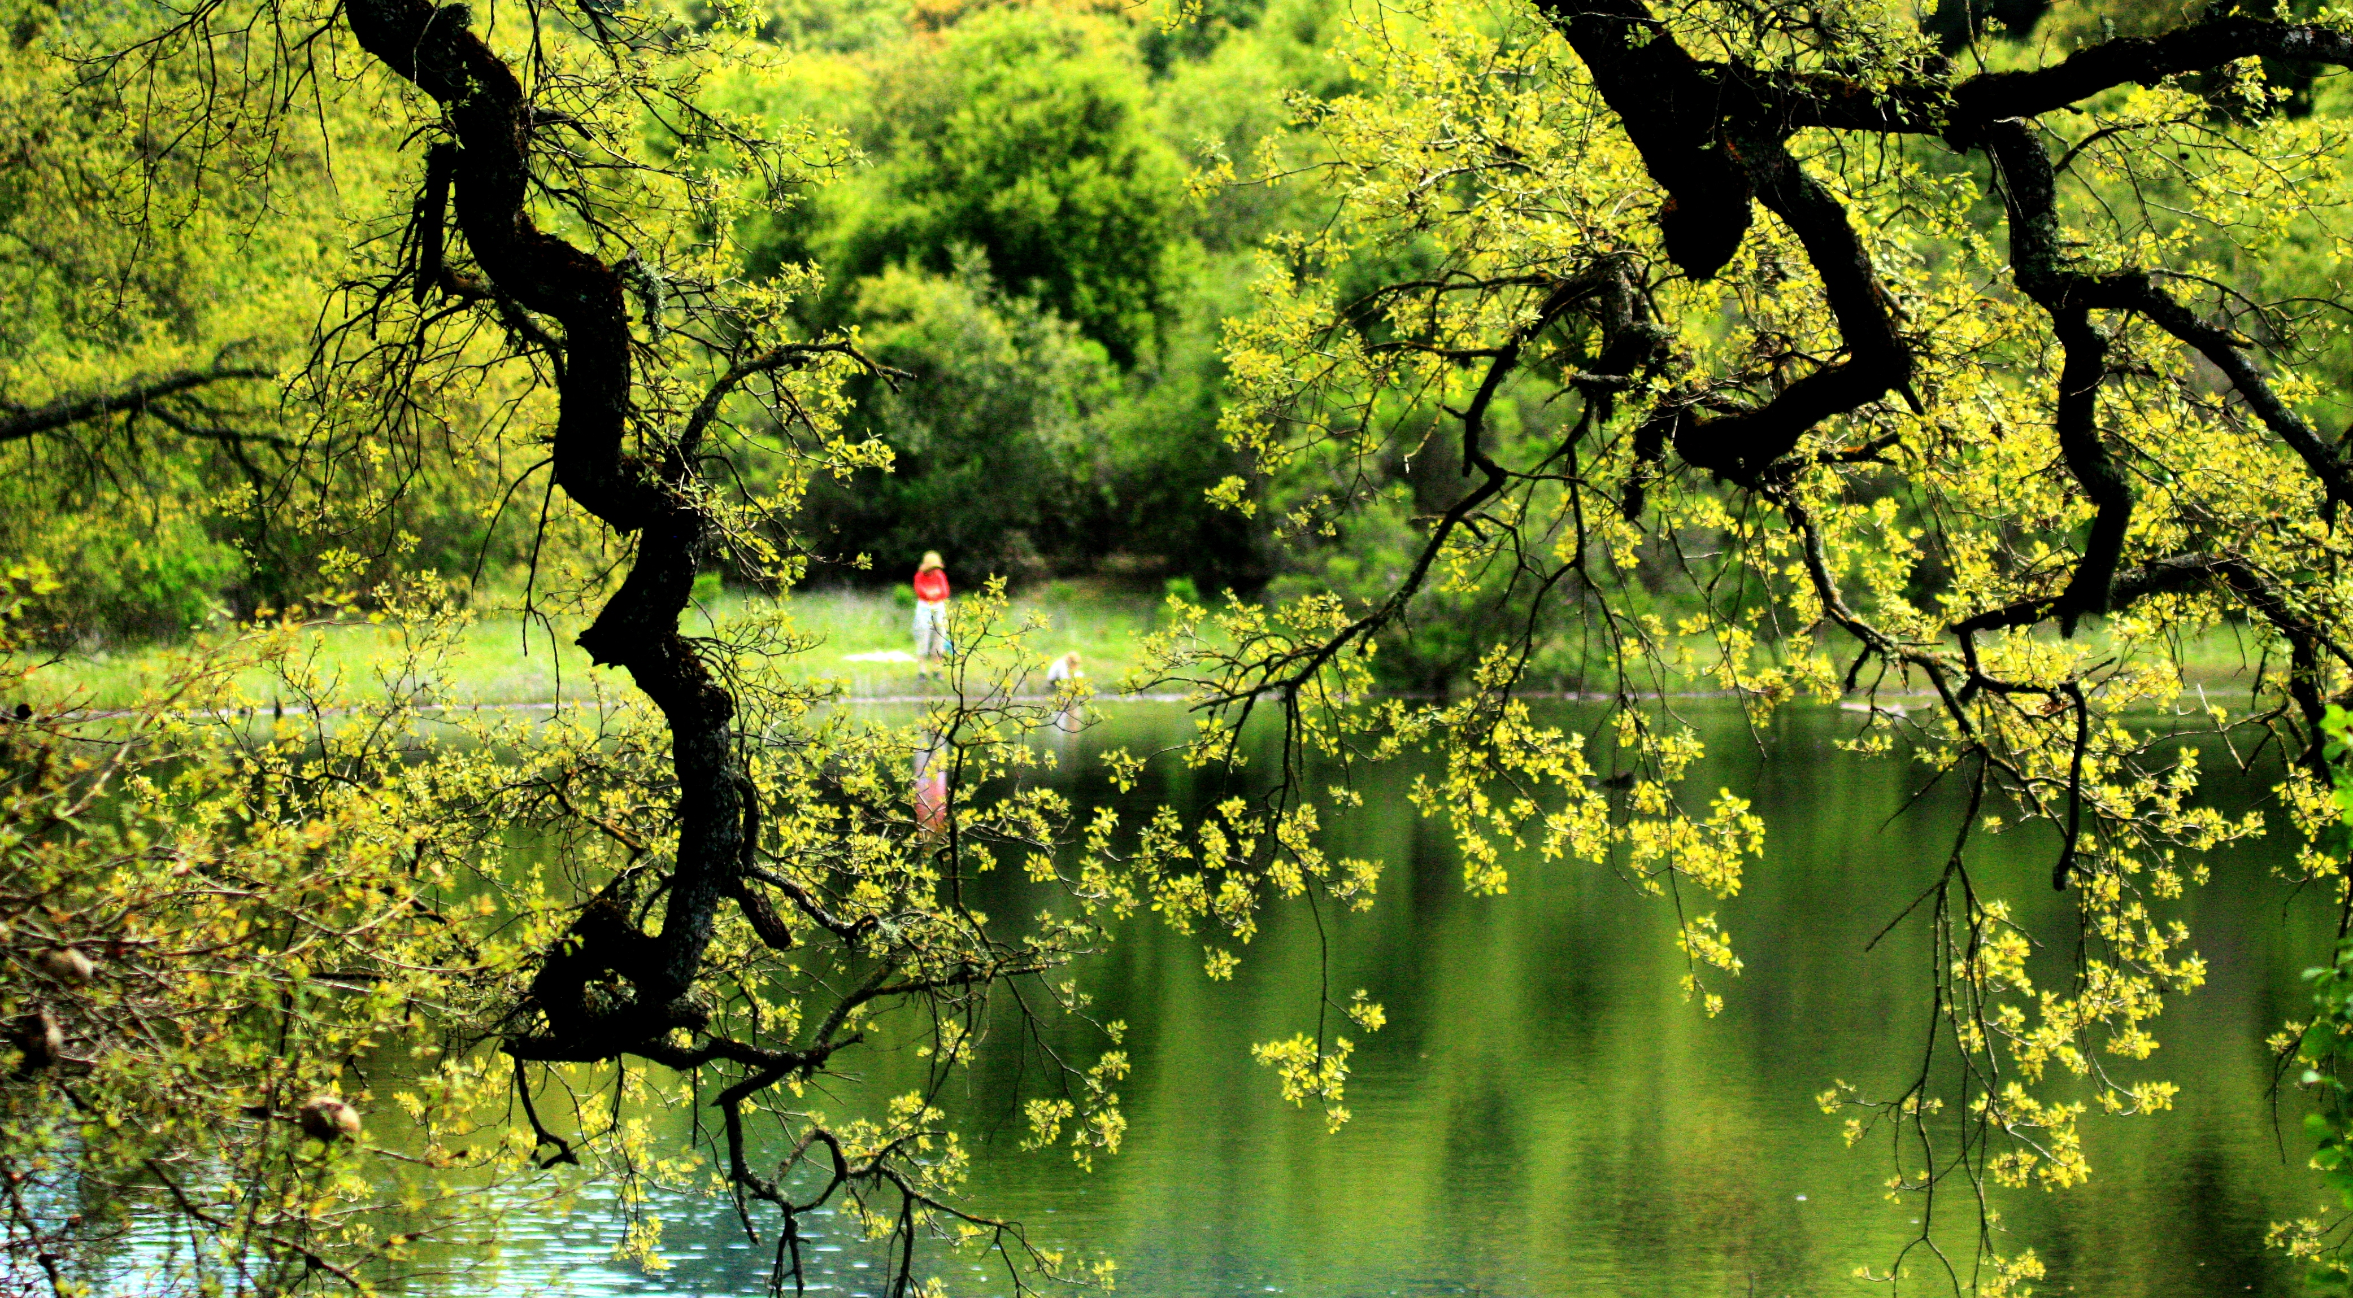
Get outdoors in the summer sun ..
Outdoor Spaces
Bushy Park
Richmond Park
Crane Park
Syon Park
The Woodlands Park
Hyde park

Slide 3
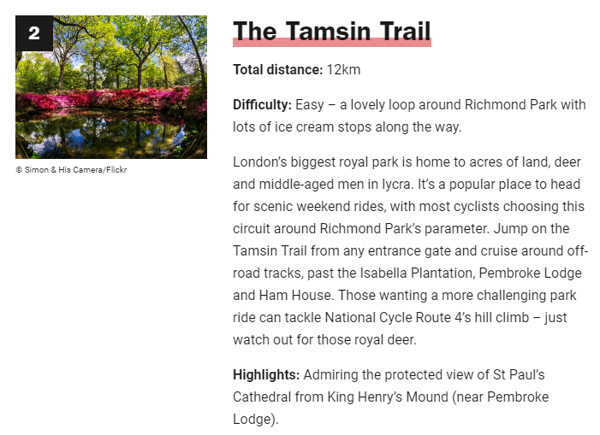
Saddle up and take on one of the beautiful cycle routes around London ..
More information: https://www.timeout.com/london/things-to-do/eleven-brilliant-bike-rides-from-london

Slide 4

Keep fit in areas of natural beauty ..
Park Runs
Junior parkrun is a series of 2k events for children aged between 4 and 14. They are held in areas of open space around the world. They are open to all, free, and are safe and easy to take part in.
If you are 14 + please come along to one of our weekly 5km Saturday parkrun events instead.
More information: https://www.parkrun.org.uk/

Slide 5
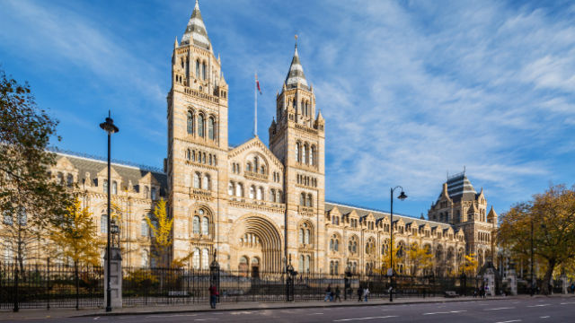
Bring History Alive ..
British Museum
Natural History Museum
National Gallery
Science Museum
Victoria and Albert (V&A)
Tate Modern
Musuem of London
Imperial War Museum
National Maritime Museum
V&A Museum of Childhood
More information: https://www.visitlondon.com/things-to-do/sightseeing/london-attraction/museum/free-museums-in-london

Slide 6
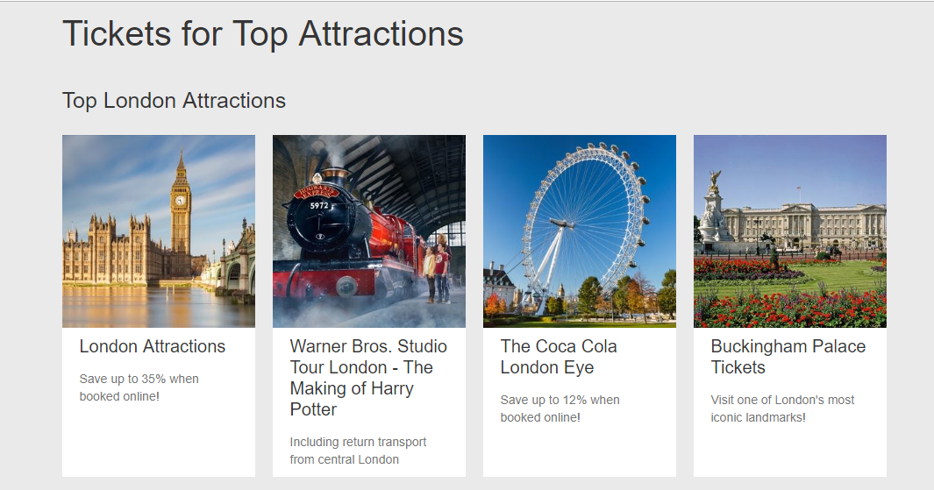
Visit one of London’s Top Attractions
More information:
https://tickets.london/attraction-tickets?_ga=2.115877446.1168537967.1561302155-639273183.1561302155

Slide 7
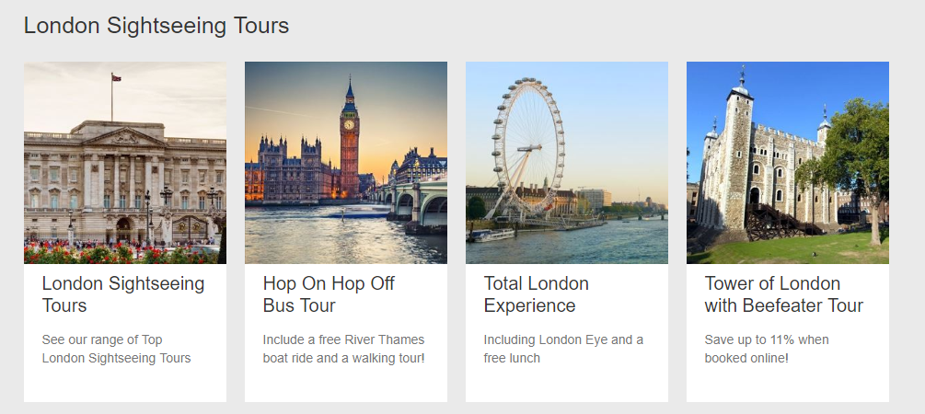
A day of sightseeing in the city
More information: https://tickets.london/attraction-tickets?_ga=2.115877446.1168537967.1561302155-639273183.1561302155

